Slide 1

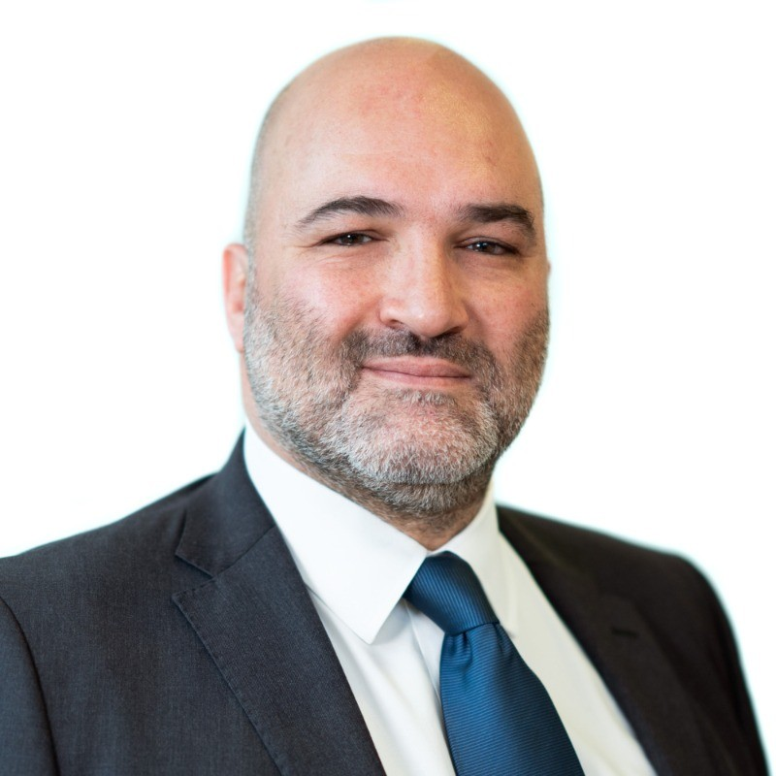
Macro Microscope
A Decoupling World Offers More Diversification Opportunities
July 2025
Indrani De
Head of Global Investment Research
FTSE Russell, LSEG
John Dioufas
Director, Datastream and Macroeconomics
LSEG

Slide 2
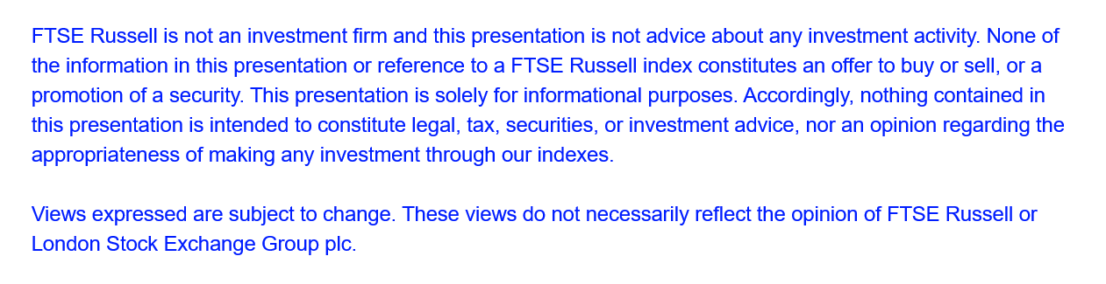

Slide 3
Decoupling world offers more diversification opportunities: Drop in correlations (1Y vs 3Y) within Equities
Source: FTSE Russell and LSEG. Data as of June 30, 2025. Past performance is no guarantee of future results. For professional investors only.
3

Slide 4
Decoupling world offers more diversification opportunities: Drop in correlations (1Y vs 3Y) Cross-Asset
Source: FTSE Russell and LSEG. Data as of June 30, 2025. Past performance is no guarantee of future results. For professional investors only.
4

Slide 5
Decoupling world offers more diversification opportunities: 1Y correlation for Russell 1000
< 0.4 correlation between US equities and:
Japan, Developed Europe, EM equities.
Investment grade corporate bonds, sovereign & inflation lined bonds
Listed infrastructure
Gold
Source: FTSE Russell and LSEG. Data as of June 30, 2025. Past performance is no guarantee of future results. For professional investors only.
5

Slide 6
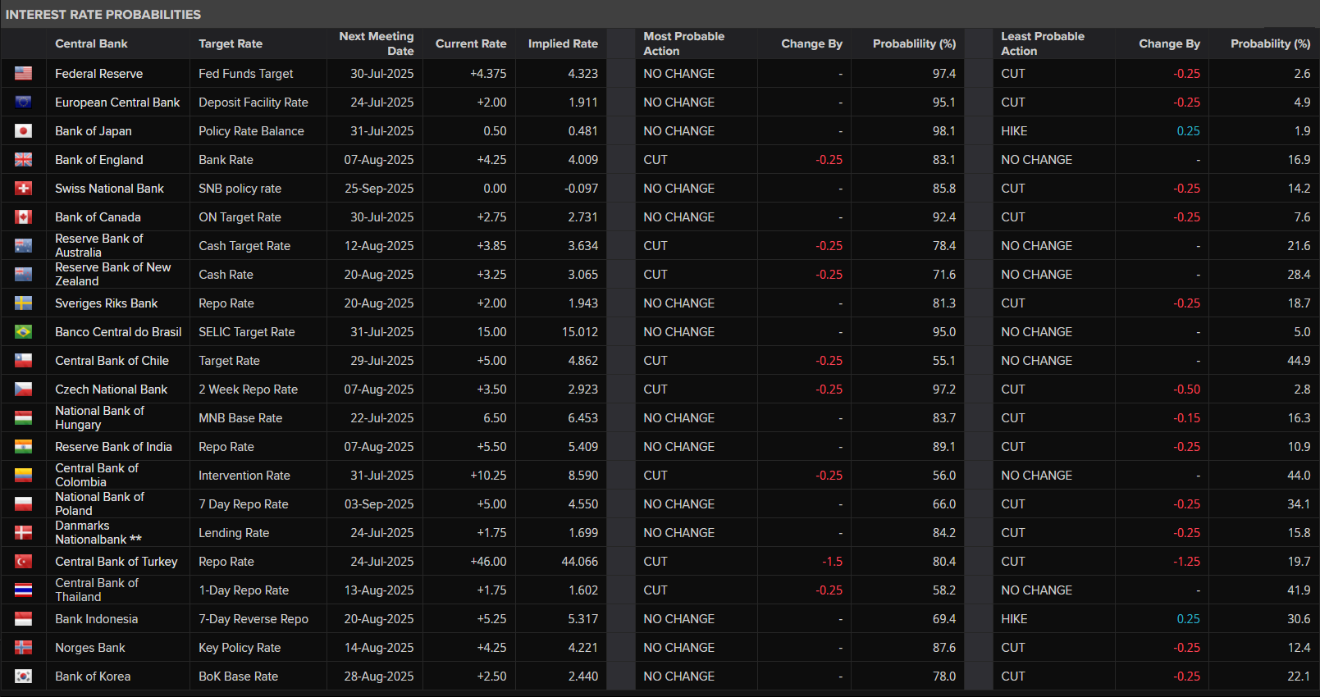
Divergence in Central Bank Monetary Policy
Source: LSEG Datastream & Macroeconomics as of 16-July-2025
LSEG
6

Slide 7
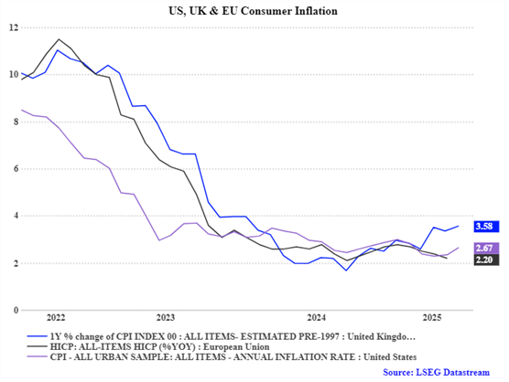
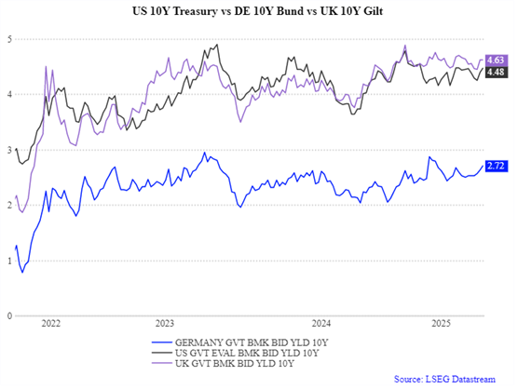
Differing Inflationary Environments resulting in Different Yields in Government Debt
Source: LSEG Datastream & Macroeconomics as of 16-July-2025
LSEG
7

Slide 8
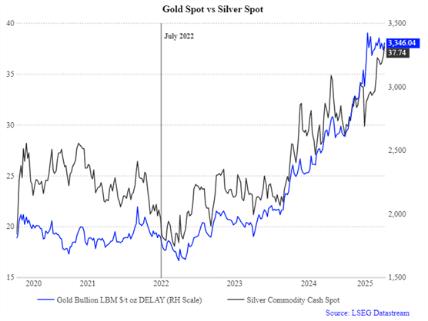
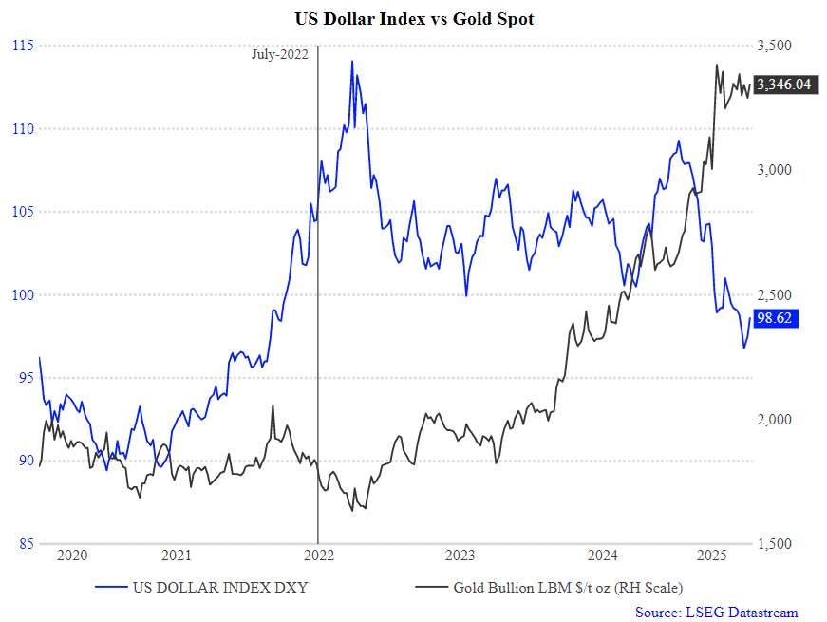
Continued Movement of Funds to Precious Metals, with Divergence in Dollar Index vs Spot Gold
Source: LSEG Datastream & Macroeconomics as of 16-July-2025
LSEG
8

